Slide 1




WeatherWise
Historical Weather Insights at Your Fingertips
Theme: Will It rain on my Parade?
Event: A NASA Space Apps Challenge Project
Team: By Saksham Talwar & Harshita

Slide 2
The Problem
Inaccessible Data
Vast Data: NASA and other space agencies have decades of valuable climate data from satellites and ground stations, covering everything from temperature and precipitation to wind speed.
Complex Format: This data is often stored in complex scientific formats that are difficult for the general public to access, parse, and understand.
No Simple Tool: There isn't an easy-to-use tool for a non-expert (like a wedding planner or a marathon organizer) to query this data for a specific day and location.

Slide 3
The Challenge: Build a Solution
Your task, which you accomplished with WeatherWise, was to:
Access and Process Data: Connect to a source of historical climate data (like the Open-Meteo API you used, which processes data from models like ERA5).
Create a User-Friendly Interface: Build an app where a user can easily select any location on Earth and a date.
Visualize the Trends: Display the historical data in a way that is simple to understand, such as charts, graphs, and summary statistics.
Provide Actionable Insight: Help the user make an informed decision about their event's potential weather. Your "Weather Suggestion" card does this perfectly.

Slide 4
How WeatherWise Works
WeatherWise is a full-stack application composed of a React frontend (what the user sees and interacts with) and a Python Flask backend (which handles data processing). The workflow is a seamless cycle from user interaction to data visualization.
0. User Interaction (Frontend)
Location & Date Selection: The user begins by selecting a location on the interactive Leaflet map and a specific day of the year using the pop-up calendar.
Triggering the Analysis: The user clicks the "Get Historical Analysis" button. This action initiates the data-fetching process.
Loading State: The React application immediately enters a 'loading' state. The UI transitions—the map panel resizes, and a loading screen appears with animated quotes, providing feedback that the request is being processed.

Slide 5
1. Data Processing (Backend)
Receiving the Request: The Flask server receives the request and extracts the location and date parameters.
Querying External API: The backend then acts as a client itself, making a request to the Open-Meteo Historical Weather API. It requests 20 years of daily weather data (temperature, wind speed, precipitation) for the specified coordinates.
Data Aggregation: The backend receives a large JSON payload from Open-Meteo containing data for every day over the last 20 years.
Processing & Structuring: The Python code processes this raw data. It filters for the specific day across all 20 years, calculates key statistics (like the mean), and structures the results into a clean, lightweight JSON object, ready for visualization.
Sending the Response: The Flask server sends this processed JSON object back to the React frontend as the response to its initial request.

Slide 6
2. Displaying Results (Frontend)
Receiving Data: The React app's fetch call completes, and it receives the processed JSON from the backend.
Crash-Proofing: The code first performs defensive checks to ensure the data is complete. If any value is missing, it prepares to display 'N/A' instead of crashing the application.
Updating State: The received data is used to update the application's state using React hooks (useState). This includes setHistoricalData, setSummaryData, and determining the overall weatherType (e.g., 'rainy', 'sunny').
Triggering Re-render: The layoutState is changed from loading to results. This state change tells React to re-render the component.
Visualizing Data: React efficiently updates the UI. The loading screen disappears, and the results grid appears, populating the charts (Chart.js), summary cards, and the 3D weather icon (React Three Fiber) with the new data from the state.
This entire cycle, from a user's click to the final data display, creates a dynamic and responsive experience.

Slide 7
3. Frontend to Backend Communication (API Call)
HTTP Request: The React frontend constructs and sends an async fetch request to a specific endpoint on the Python Flask backend (e.g., /api/historical-stats).
Sending Parameters: The selected latitude, longitude, month, and day are passed as query parameters in the API request URL. For example: .../api/historical-stats?lat=38.88&lon=-77.01&month=10&day=5.

Slide 8
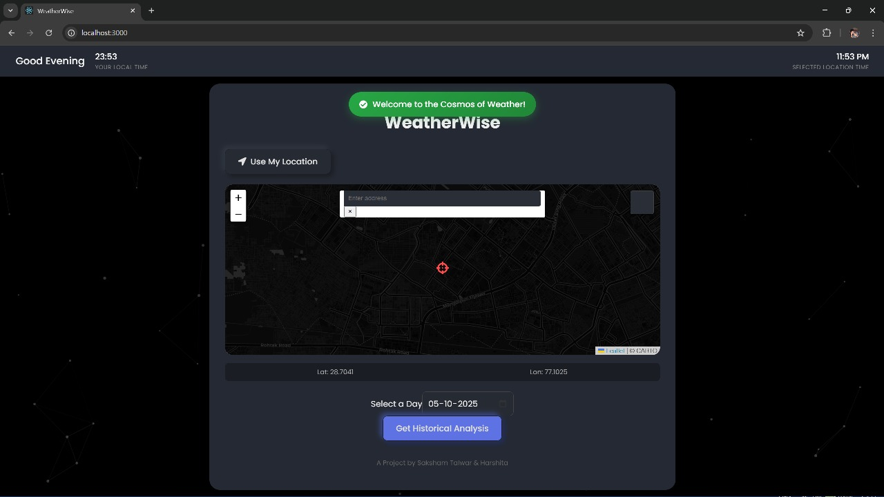
Core Functionality
Historical Weather Analysis: Fetches and processes 20 years of historical weather data for any selected date and location on Earth.
Key Data Points: Analyzes long-term trends for three primary weather variables: Temperature, Wind Speed, and Precipitation.
Statistical Summaries: Automatically calculates and displays key metrics, including the historical average temperature, average wind speed, and the percentage chance of rain for the selected day.

Slide 9
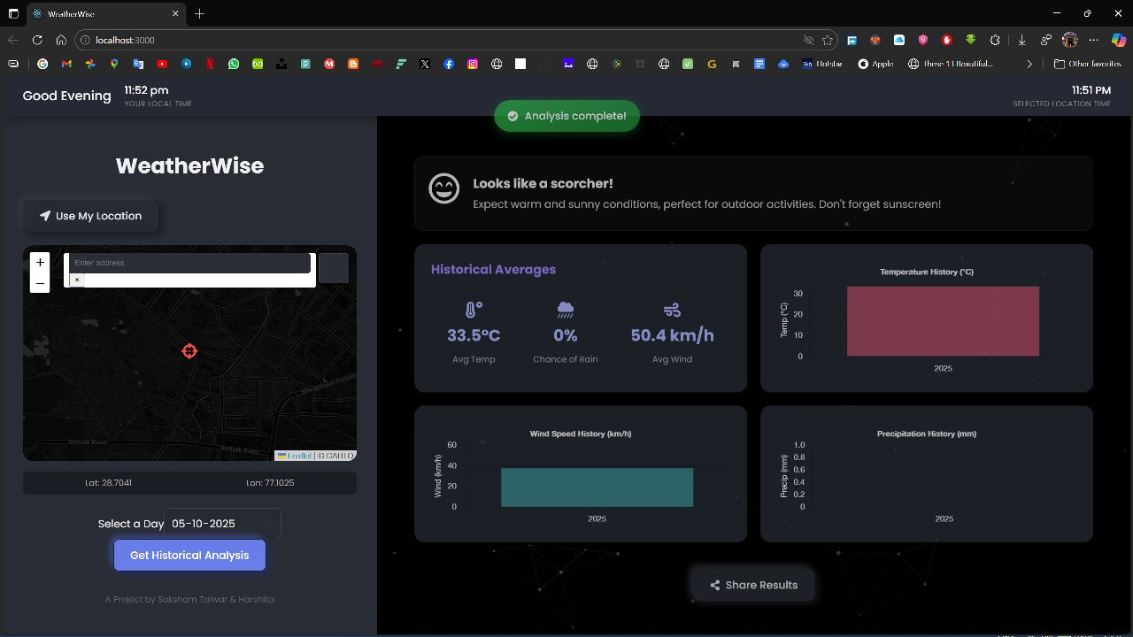
Data Visualization
20-Year Trend Charts: Generates three distinct bar charts (Chart.js) to clearly visualize the historical trends of temperature, wind, and precipitation over the last two decades.
Dynamic 3D Weather Icons: A unique 3D icon (sun, clouds, rain), rendered with React Three Fiber, provides a beautiful and immediate visual summary of the historical weather "vibe" for that day.
Thematic Suggestions: Presents data-driven insights in a fun, accessible way, with thematic titles like "Will it Rain on Your Parade?" appearing when data conditions are met.

Slide 10
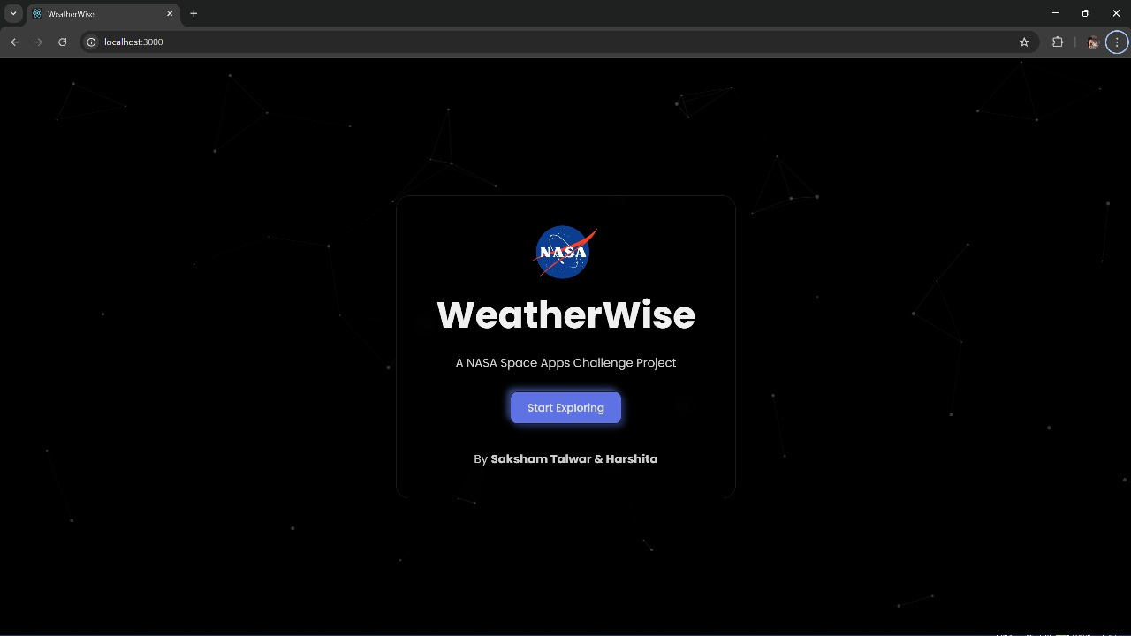
User Experience (UX)
Immersive Theming: A sleek, dark-black "cosmic" theme with an animated particle background (tsparticles) creates an engaging and modern user environment.
Smooth Transitions: The UI animates smoothly between the initial map view and the detailed results panel, creating a seamless user flow.
Real-Time Feedback: Provides a rich user experience with:
An animated loading screen with rotating quotes.
System notifications for success and error states.
A live-updating clock that shows both the user's local time and the time at the selected location.
Brand Integration: Proudly features the NASA logo on both the welcome screen and the main dashboard to signify its origin as a NASA Space Apps Challenge project.

Slide 11
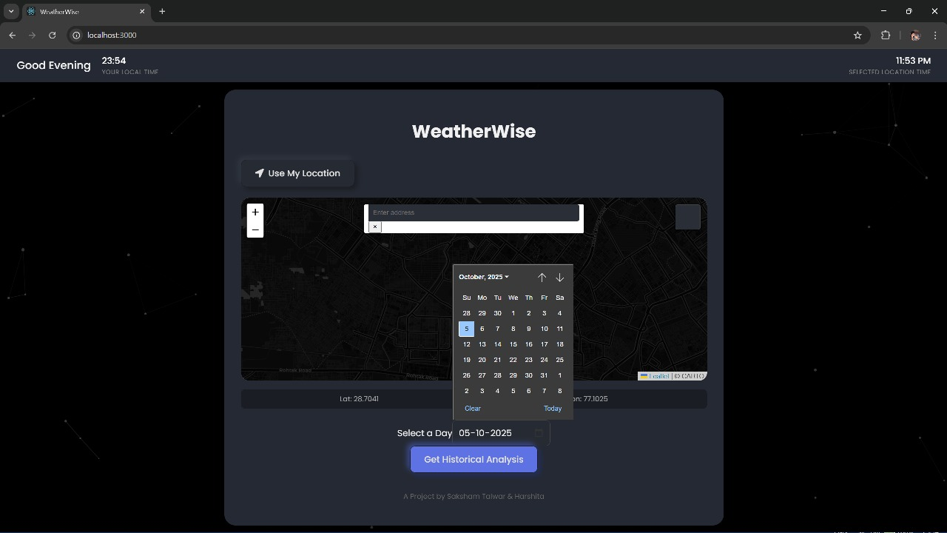
Interactive Elements
Global Map Interface: An interactive, dark-themed Leaflet map serves as the primary tool for exploration and location selection.
Multiple Selection Methods: Users can select a location in three intuitive ways:
Pan-to-Select: Dragging the map under a fixed central pin.
Search: Finding a location by name using the integrated search bar.
Geolocation: Automatically detecting the user's current location with the "Use My Location" button, which includes a reverse-geocoded place name notification.
Interactive Calendar: A clean, pop-up calendar (react-calendar) provides a user-friendly way to select any day of the year.
Map Controls: Includes features to Save a favorite location to the browser's local storage and Lock/Unlock map movement for easier analysis.

